Slide 1
Data Structures & Algorithms
Week 3
ITCS 2214 @ CCI at UNC Charlotte
Adapted from Dr. Celine Latulipe‘s original version
Qiong Cheng

Slide 2
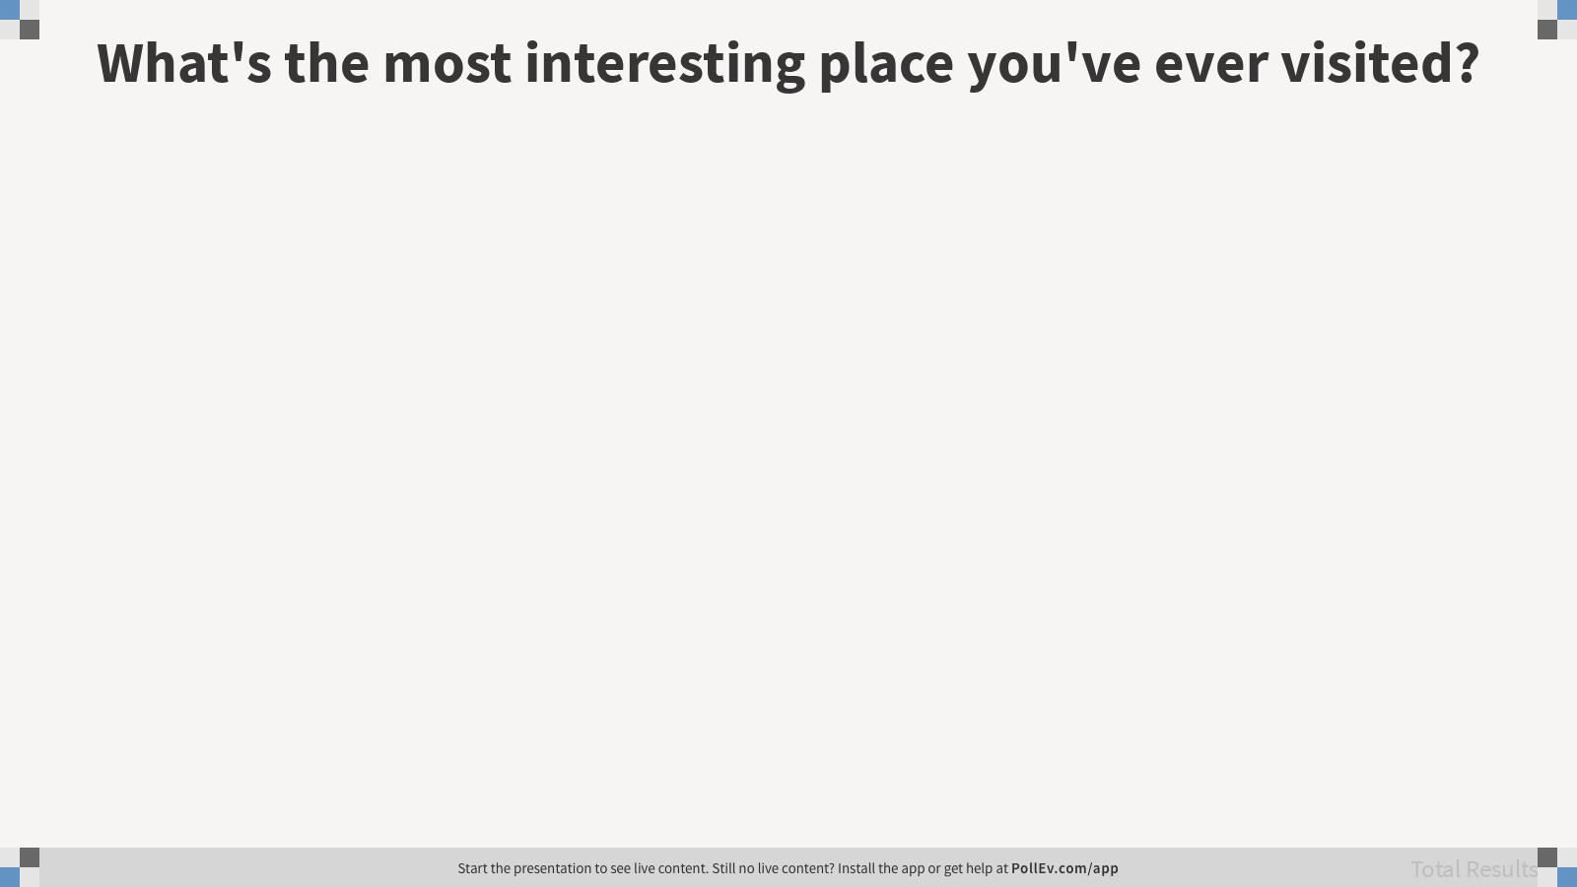
Notes:
What's the most interesting place you've ever visited?
https://www.polleverywhere.com/free_text_polls/ATQTiaa8m9eedGQGD0kZ7

Slide 3
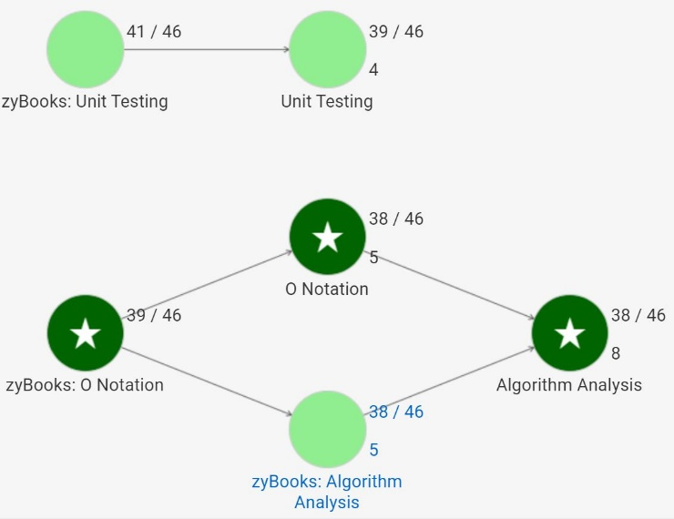
Total 88 students
79 students had full knowledge coverage
83
80
75%
81%
Realizeit Node Task | Details | ZB. PA | ZB. CA
zyBooks: O Notation | 2.1 O notation | 79
O Notation | 1. Learning material
 | 2. Questions
zyBooks: Algorithm Analysis | 2.2 Constant time operations | 87
 | 2.3 Algorithm analysis | 86
Algorithm Analysis | 1. Learning material
 | 2. Questions
zyBooks: Unit Testing | 2.5 Unit testing methods (EO) |  | 79
 | 2.6 Unit testing (classes) | 90 | 72
Unit Testing | 1. Learning material
 | 2. Learning material
 | 3. Questions
79
77%
83
79
81%
70%
81
74%

Slide 4
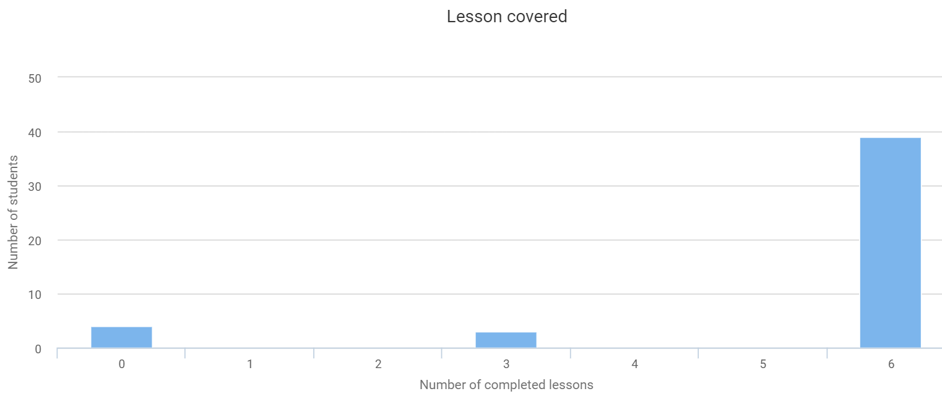
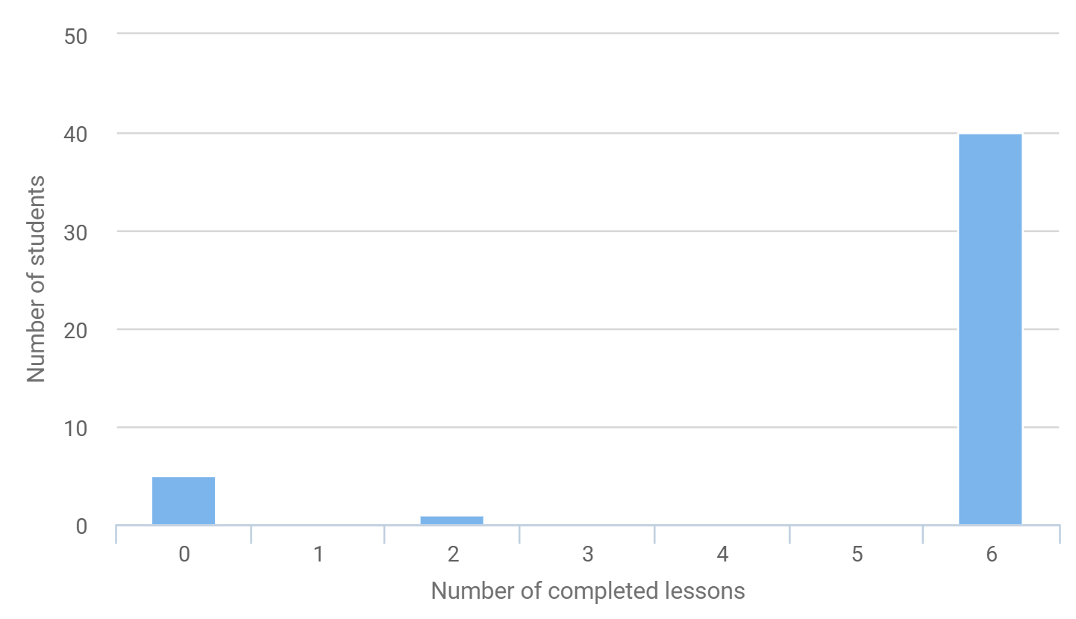
Lesson Covered Distribution
Y03:
Y04:

Slide 5
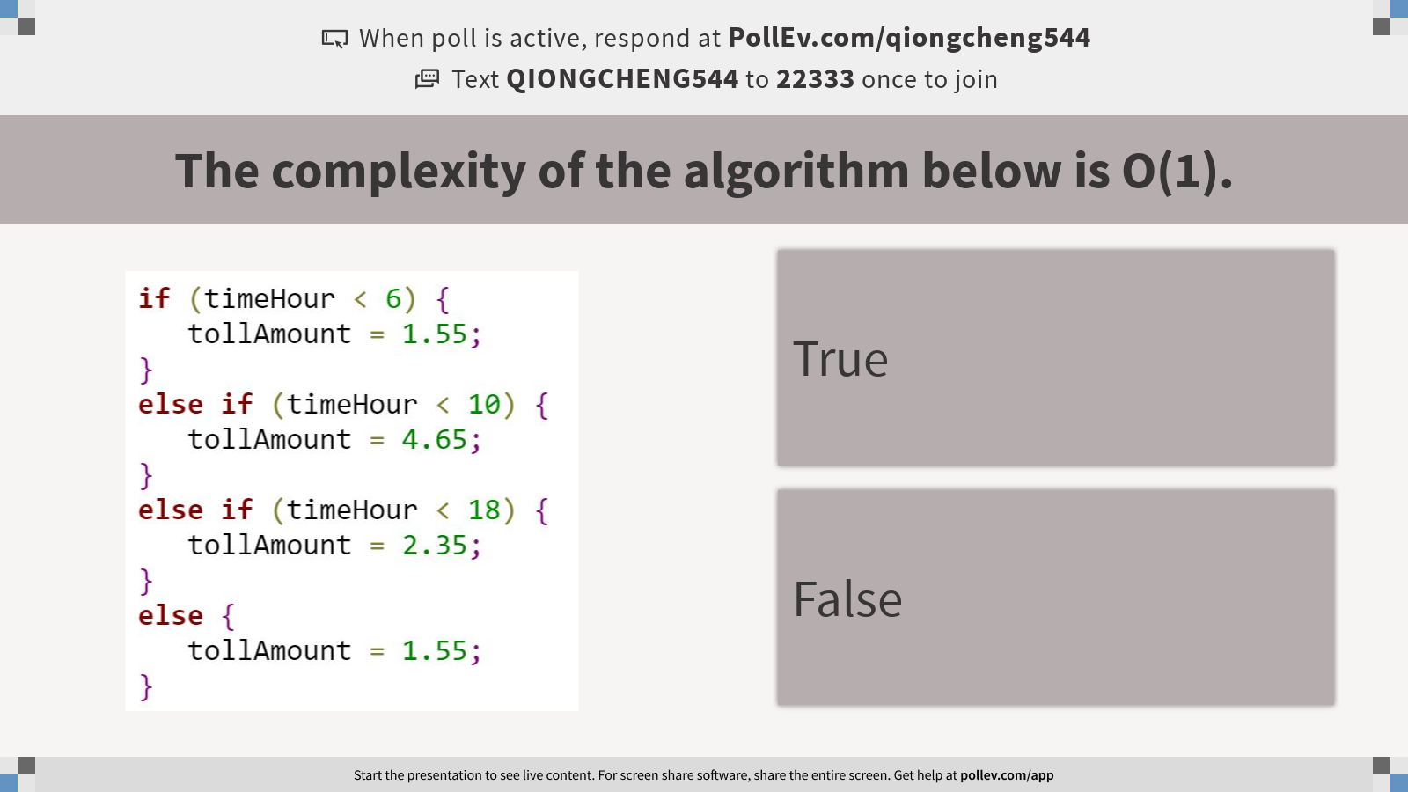
Notes:
Poll Title: The complexity of the algorithm below is O(1). https://www.polleverywhere.com/multiple_choice_polls/6wNk4E2mfUjZMNV7nhA38?display_state=instructions&activity_state=opened&state=opened&flow=Instructor&onscreen=persist

Slide 6
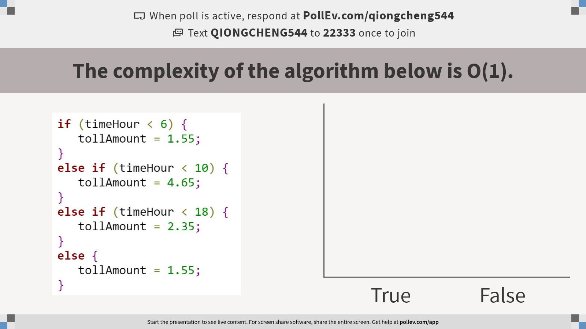
Notes:
Poll Title: The complexity of the algorithm below is O(1). https://www.polleverywhere.com/multiple_choice_polls/6wNk4E2mfUjZMNV7nhA38?display_state=chart&activity_state=closed&state=closed&flow=Instructor&onscreen=persist

Slide 7
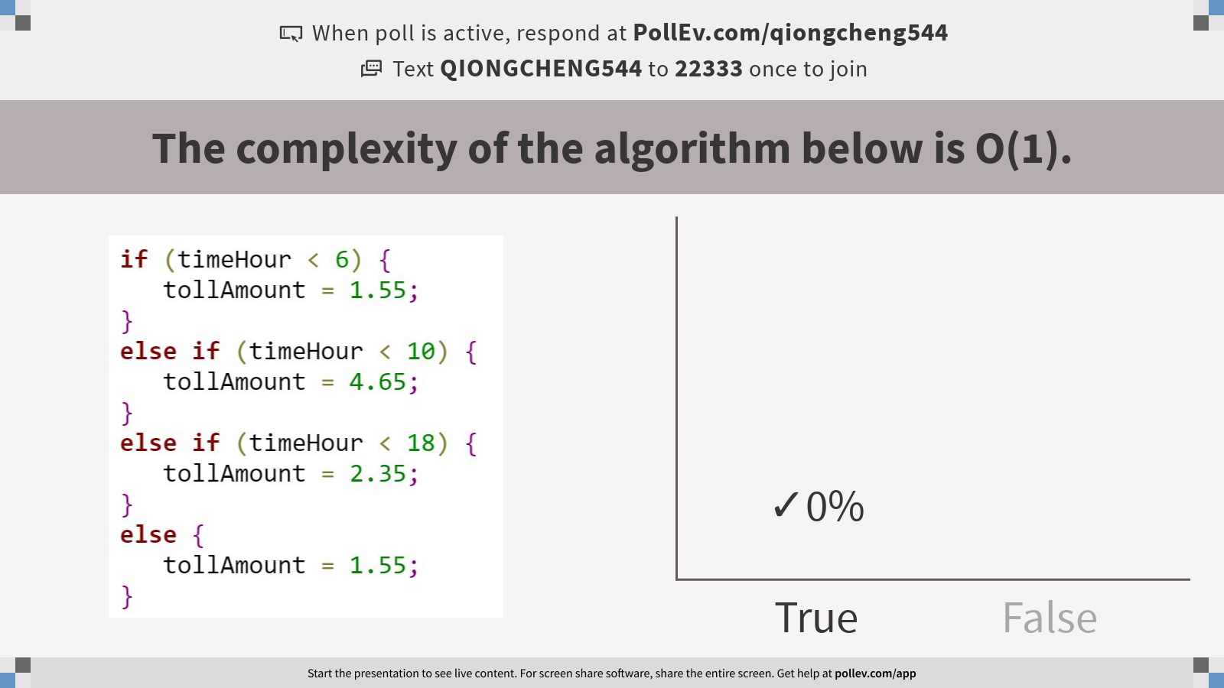
Notes:
Poll Title: The complexity of the algorithm below is O(1). https://www.polleverywhere.com/multiple_choice_polls/6wNk4E2mfUjZMNV7nhA38?display_state=chart&activity_state=closed&display=correctness&state=closed&flow=Instructor&onscreen=persist

Slide 8
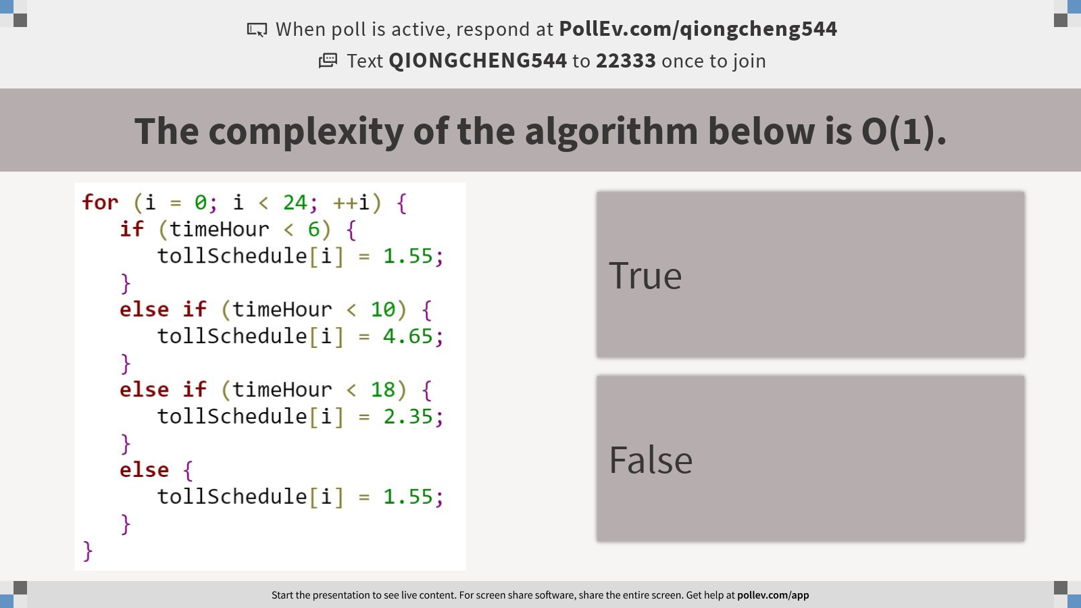
Notes:
Poll Title: The complexity of the algorithm below is O(1). https://www.polleverywhere.com/multiple_choice_polls/AcW3i8gU5k0gdi6mMPGKw?display_state=instructions&activity_state=opened&state=opened&flow=Instructor&onscreen=persist

Slide 9
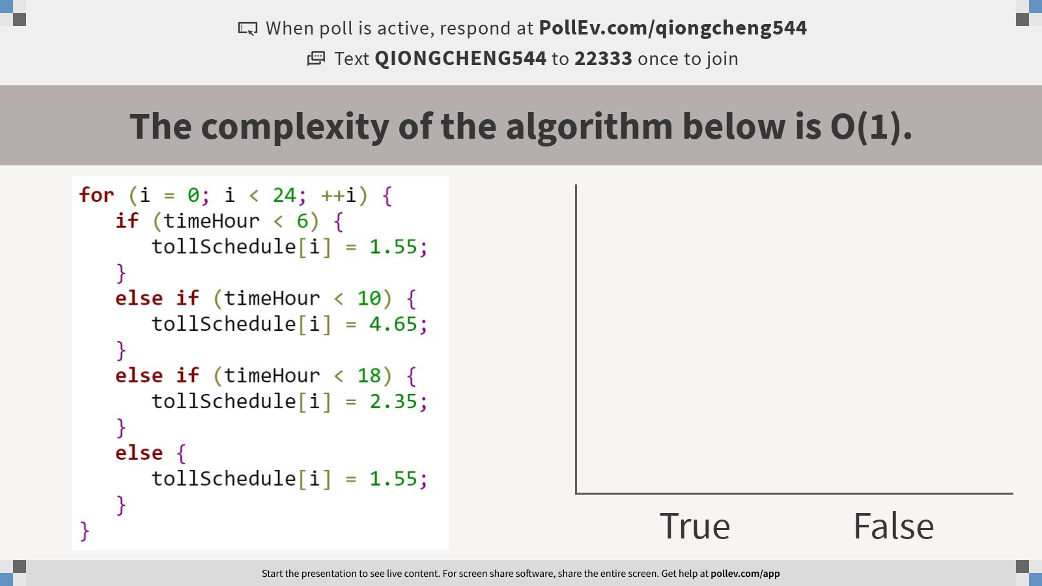
Notes:
Poll Title: The complexity of the algorithm below is O(1). https://www.polleverywhere.com/multiple_choice_polls/AcW3i8gU5k0gdi6mMPGKw?display_state=chart&activity_state=closed&state=closed&flow=Instructor&onscreen=persist

Slide 10
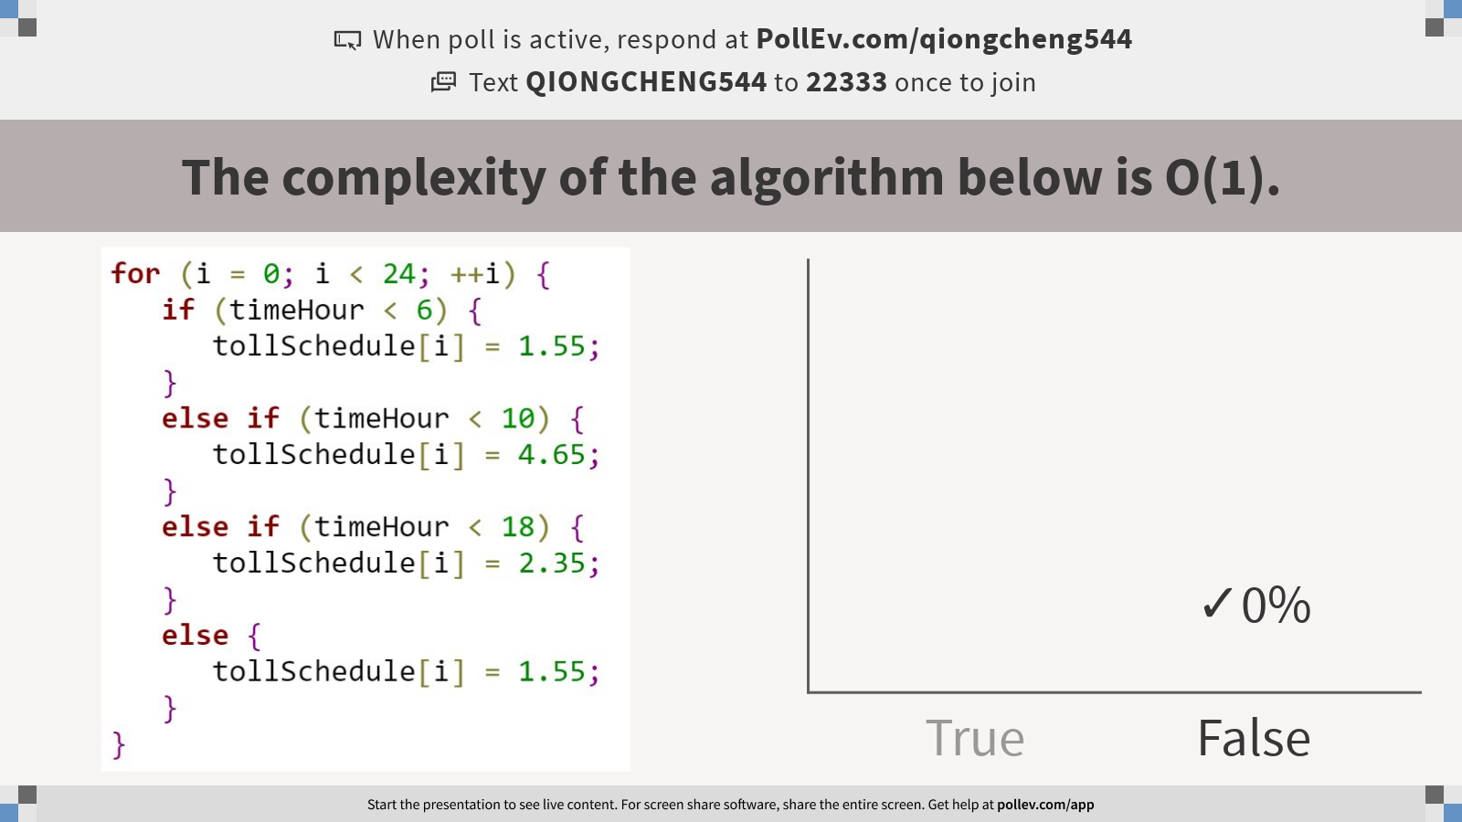
Notes:
Poll Title: The complexity of the algorithm below is O(1). https://www.polleverywhere.com/multiple_choice_polls/AcW3i8gU5k0gdi6mMPGKw?display_state=chart&activity_state=closed&display=correctness&state=closed&flow=Instructor&onscreen=persist

Slide 11
Algorithm analysis: to analyze how runtime of an algorithm scales as the input size increases to infinity

Slide 12
Time Complexity Analysis
First, count the steps under a given input instance
Best case: under a certain input instance, your codes take less step to finish.
Worst case: under a certain input instance, your codes take most step to finish

Slide 13
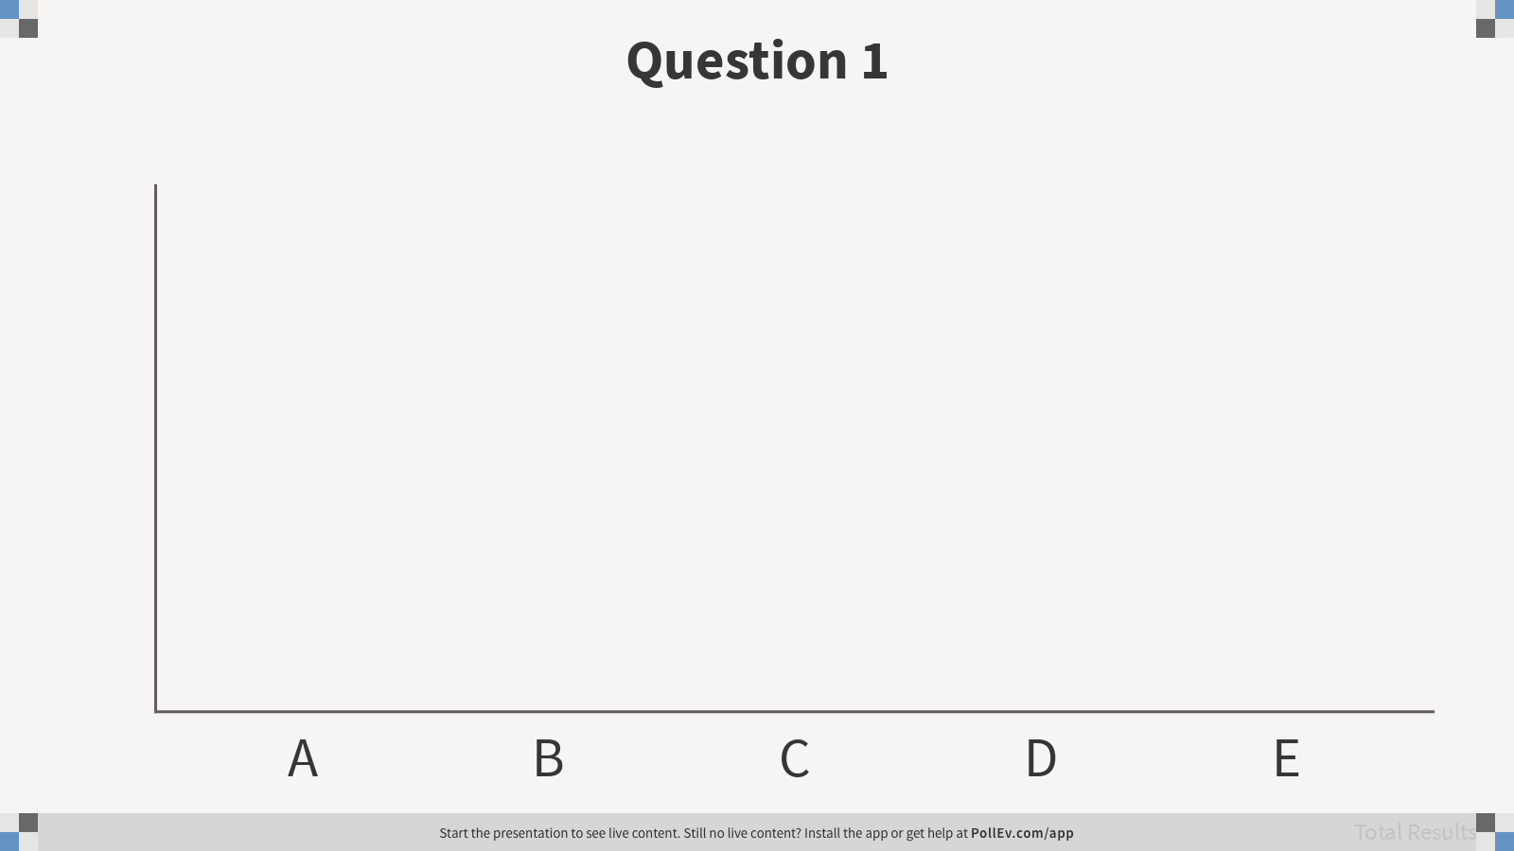
1. If we have an array that has 300 random ints, what is the best case number of comparisons that will need to be done to check and see if the array contains the number 985?
300
150
1
985
This is unknown.
Notes:
Question 1
https://www.polleverywhere.com/multiple_choice_polls/7MlZ80N6mfzEjTja85wre
C

Slide 14
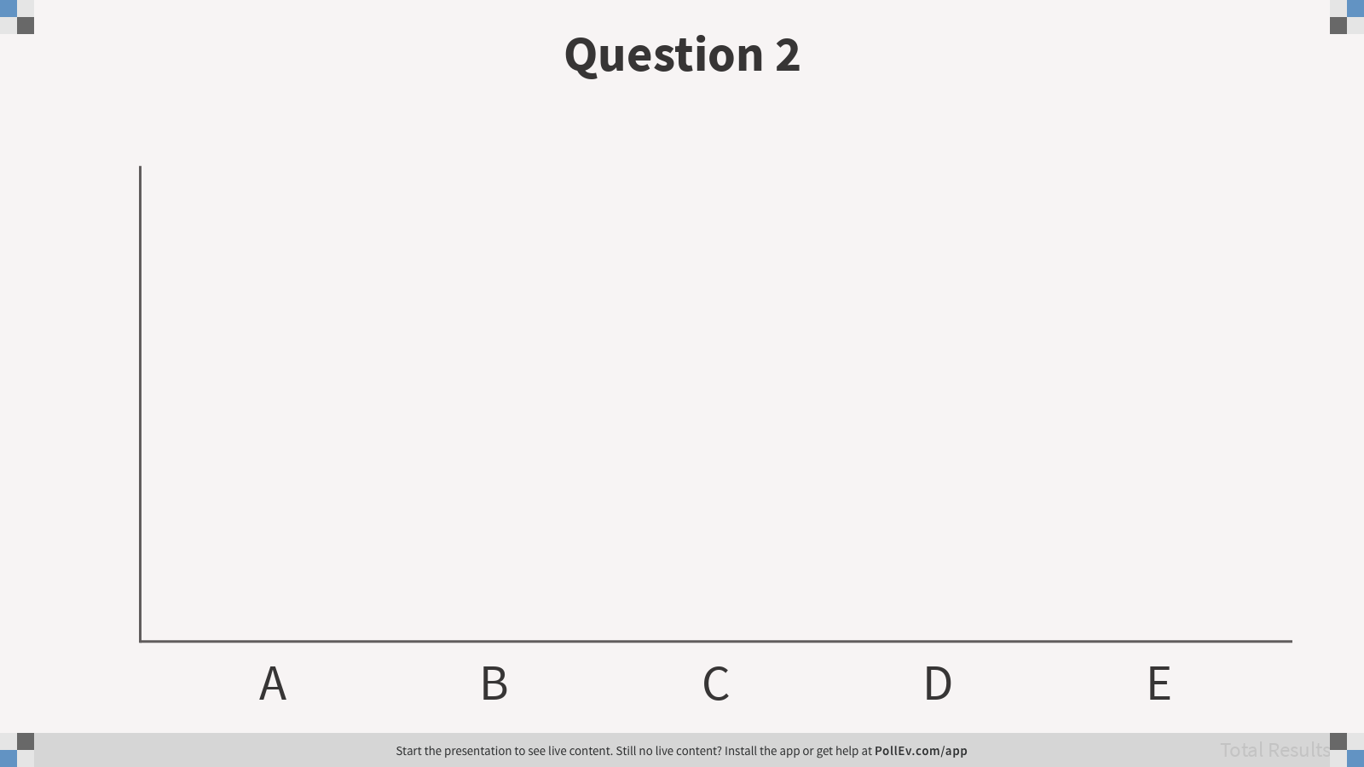
2. If we have an array that has 300 random ints, what is the worst case number of comparisons that will need to be done to check and see if the array contains the number 985?
300
150
1
985
This is unknown.
Notes:
Question 2
https://www.polleverywhere.com/multiple_choice_polls/UrQrp3N83xr64fl6qThpR
A

Slide 15
Data Structures Matrix
Draw this matrix in your sketchbook. We will be adding rows for every data structure we discuss.
Data Structure | Auto-Expand | Access | Insert at loc x | Add | Add at front | Add at end | Remove from loc x | Remove from front | Remove from end | Search | Look/Peak
Array
ArrayList
Auto-Expand: does the end-user programmer have to keep track of how much space is left and make a newer, bigger version if space runs out
Access: How many operations does it take to access a specific element in the collection? Note that access means get a copy or a reference to the element, NOT removing it.
Insert at loc x: How many ops does it take to insert an element at a specific location?
Add: How many ops does it take to add an element, assuming you don’t care where it gets stored?
Add at front: How many ops does it take to add an element to the front of the collection?
Add at end: How many ops does it take to add an element to the end of the collection?
Remove from loc x: How many ops to remove an element from a specific location in the collection?
Remove from front: How many ops does it take to remove an element to the front of the collection?
Remove from end: How many ops does it take to remove an element to the front of the collection?
Search: How many operations will it take to search through the collection to find something specific?
REMEMBER: we are thinking about the worst case scenario!

Slide 16
End-User Programmer (EUP)
The end-user programmer:
Uses data structures and other libraries provided to build software/apps to solve problems
They don’t want to reinvent the wheel
They need to know what functionality a library or data structure provides, and how to use it
They don’t usually need to know how the data structure works, under the hood

Slide 17
Data Structures Programmer (DSP)
Builds data structure classes
Often combines them into a library
Adheres to an ADT, which is public
Can use other data structures and libraries, under the hood, and need to understand how those other structures work
Can change the implementation, as long as it still adheres to the ADT
ADT (often in the form of an interface file) is like a contract between the DSP and EUP.

Slide 18
DSP vs. EUP
You will often take on both roles, at different times.
Example:
You might build a linked-list data structure (you are being the DSP)
You might then provide that to someone else so they can build a grocery list phone app (they are being the EUP)
You might also then use the linked-list to create a card game app (you are being the EUP)
The DSP-EUP distinction will become helpful for exception handling

Slide 19
 | End User Programmer | Data Structures Programmer
Arrays | They create an array, specifying size and what will be stored in it, then add and remove elements. If they run out of space, they need to create a bigger array and copy elements over. They typically have to keep track of how many elements are in the array. int index = 0; String[] myStrings = new Strings[40]; myStrings[index] = “this is a string”; index++; | They implemented the array as part of the base Java system.
ArrayLists | They create an ArrayList, specifying what type of object it will store. Then they add and remove elements. ArrayList<String> myStrings = new ArrayList<>(); myStrings.add(“this is a string”); They don’t need to keep track of how many items are in the collection because they can always call the size method to find out: int size = myStrings.size(); | They implemented the ArrayList as a Java Framework Collection, implementing the List<> interface. They wrote code that automatically expands the underlying array when it gets full. They also have code that keeps track of the number of items in the collection, etc.

Slide 20
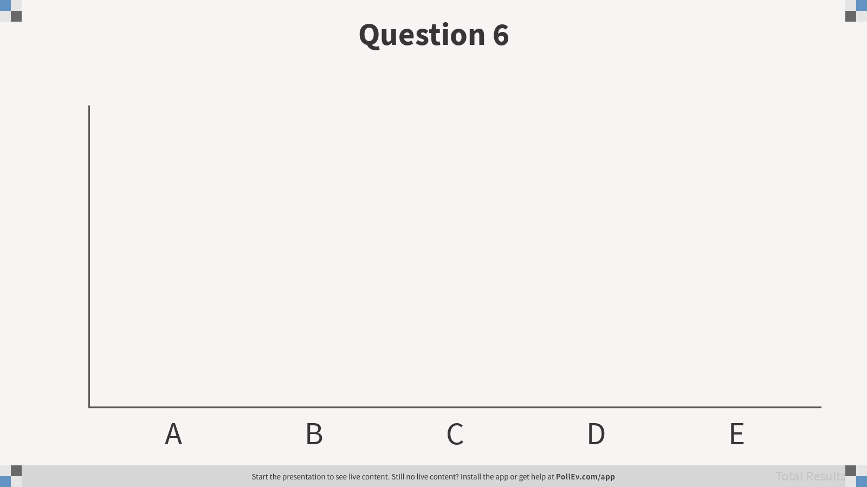
3. Which of the following is true for both an ArrayList and an array, from the End-User Programmer perspective?
Once allocated the size may not change.
A slot to hold an object may be removed.
A slot to hold an object may be inserted.
All slots must contain the same type of object (or subclass objects).
A slot can hold a primitive.
Notes:
Question 6
https://www.polleverywhere.com/multiple_choice_polls/CZITQUvWfgAjJvXSqXEAB
BCD

Slide 21
Time Complexity Analysis
Second, formulate the runtime function of input size: number of steps under the input size
An algorithm scales up as the dataset grows. But different algorithms scales differently. We care about the scale rate more.
Then determine the big O notation of runtime function

Slide 22
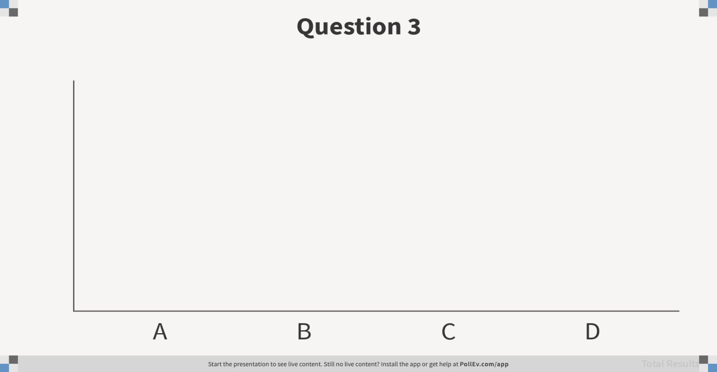
4. This graph shows how number of operations expands as the size of data expands. If you have 100 elements in your collection and you run a linear algorithm (O(n)), it takes 100 operations. If you have 20 elements and you run a polynomial algorithm, which option is closest to the answer for how many operations will it take?
20
100
~400
unknown
Notes:
Question 3
https://www.polleverywhere.com/multiple_choice_polls/bye4FS90EzNMDtFyCvRH8
C

Slide 23
Big O notation - categorizing algorithmic growth rate
Big O notation is used in Computer Science to describe the performance or complexity of an algorithm. As for a single algorithm, we use Big O notation to categorize the growth rate function of algorithms as input size goes to the infinity.
In Big O notation, all functions that have the same growth rate (as determined by the highest order term of the function) are characterized using the same Big O notation.
Which of the following Big O notations is equivalent to O(N+9999)?

Slide 24
Guideline for General Algorithmic Time Complexity Analysis
Decide on parameter n indicating input size
Identify algorithm’s basic operation which involves input instance
Determine worst, average, and best cases for input of size n
Count steps and set up a sum for the number of times the basic operation is executed
Simplify the sum using standard formulas and rules
Ignore the lower-order subexpression(s)
Ignore the coefficient of the highest-order subexpression

Slide 25
Big O notation - categorizing algorithmic growth rate
Given a function that describes the running time of an algorithm, the Big O notation for that function can be determined using the following rules:
If f(x) is a sum of several terms, the highest order term (the one with the fastest growth rate) is kept and others are discarded.
If f(x) has a term that is a product of several factors, all constants (those that are not in terms of x) are omitted.

Slide 26
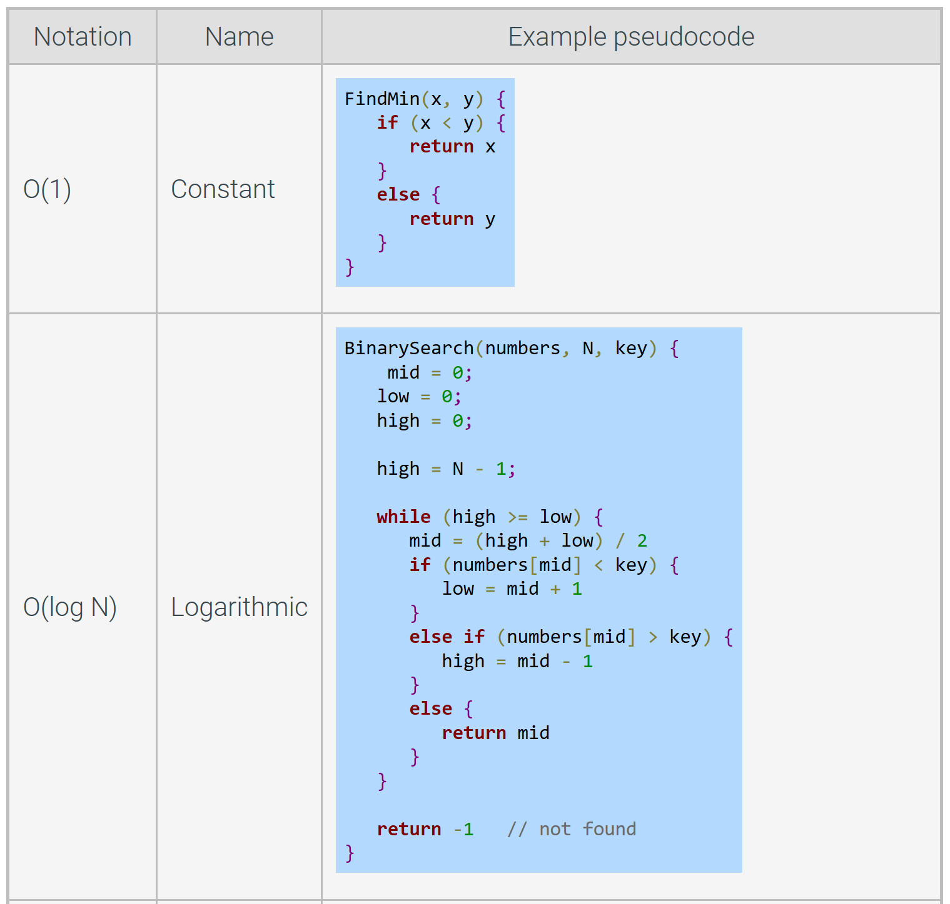

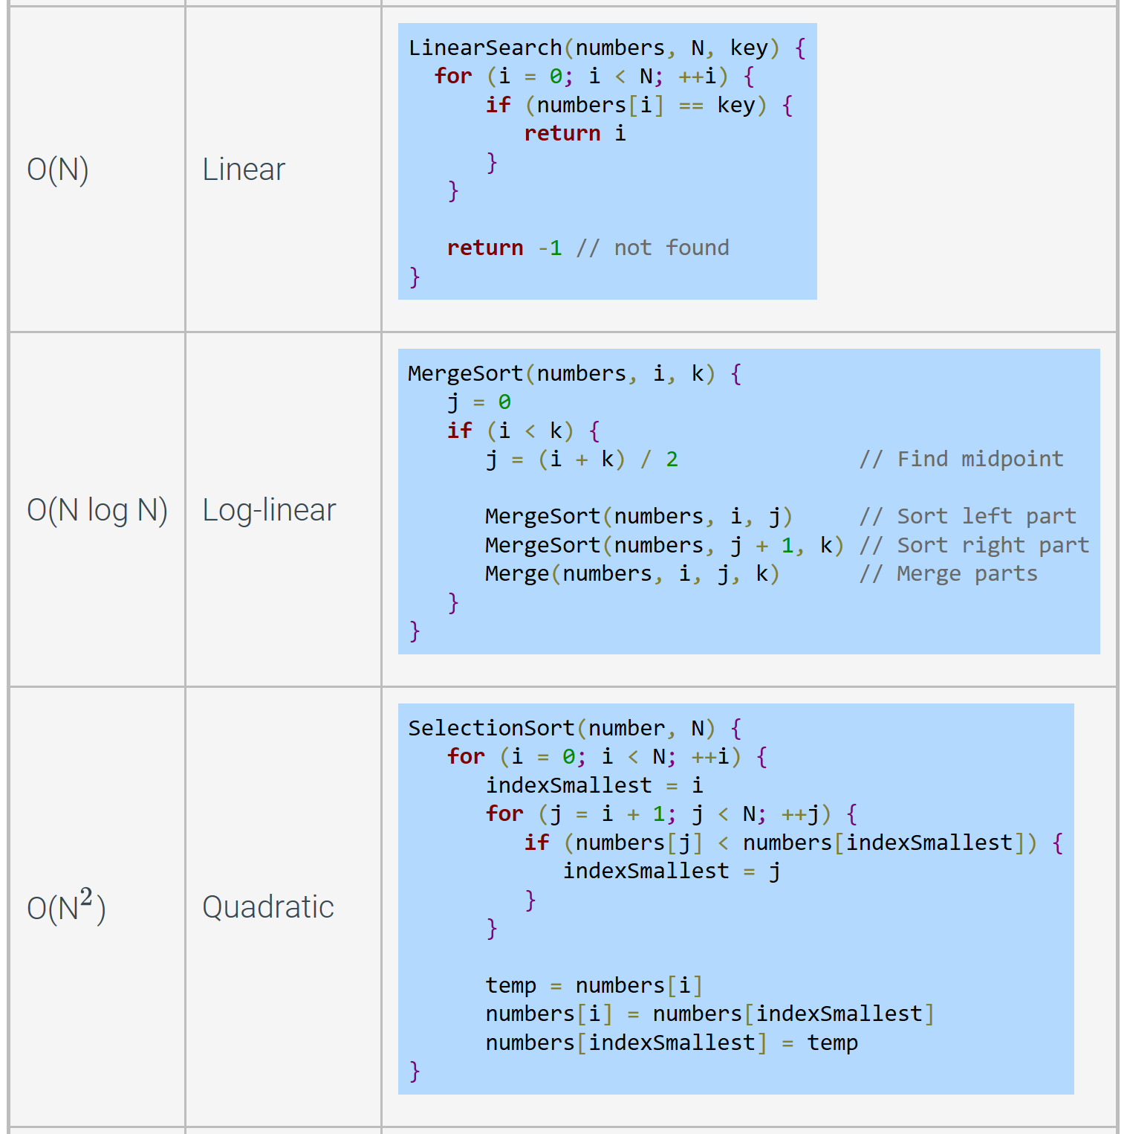
Runtime complexities for various pseudocode examples.

Slide 27
Both quadratic and cubic are considered “polynomial time”
O(2^{n})
O(n³)
O(n²)
O(n log n)
O(n)
O(log n)

Slide 28
A) O(l)
B) O(n)
C) O(1)
D) O(log n)
E) O(l²)
F) O(n + l)
G) O(n²)
What is the complexity of the GraduateFromUNCC method?
public void GraduateFromUNCC(byte z)
{
z=z+15;
System.out.println(z);
}
Notes:
C

Slide 29
What is the complexity of the following:
for (int k=1; k<n ; k++) { l=1; while(l<n) { l=l+38; System.out.println(k+l); } }
A) O(l)
B) O(n)
C) O(1)
D) O(log n)
E) O(l²)
F) O(n + l)
G) O(n²)
Notes:
G

Slide 30
The complexity of both methods (Method1 and Method2) is O(n²).
public void Method1(int n) { for(int j=1; j< n ; j++) for(int b =1; b< n; b++) System.out.println (b); System.out.println("Inheritance"); } public void Method2(int n) { for(int j =1; j < n ; j++) System.out.println("Inheritance"); for(int b =1; b < n; b++) System.out.println (b); }
True
False
Notes:
B

Slide 31
What would be the Big O Complexity for the following method?
public boolean crossRoad(boolean isSafe, int height, int length) { if (isSafe) { return true; } else if (height < 11) { return true; } else { return length > 25; } }
A) O(N)
B) O(length²)
C) O(height)
D) O(1)
E) O(length)
F) O(height²)
G) O(log height)
Notes:
D

Slide 32
Assume that d is a positive integer and A is an array containing d items. Execution of the following code fragment is _____.
for (int j = 0; j < d; j++) {
System.out.println( A[j] );
}
A) O(1)
B) O(log d)
C) O(d²)
D) O(d)
Notes:
D

Slide 33
Which line of code will take more time to execute in an ArrayList named 'movies' that is 12 items long?
A) movies.remove(4);
B) movies.remove(numbers.size() -1);
C) movies.remove(9);
Notes:
A

Slide 34
If an algorithm is inefficient, a faster processor will help in the long run.
True
False

Slide 35
Assume that d is a positive integer.
int j = d;
while (j > 0) {
int sum = 0;
for (int x = 0; x < d; x++)
sum++;
System.out.println(sum);
j--;
}
Execution of this code fragment is _____.
A) O(d)
B) O(j)
C) O(d log d)
D) O(1)
E) O(x)
F) O(2^{j})
G) O(d²)
H) O(x²)
Notes:
G

Slide 36
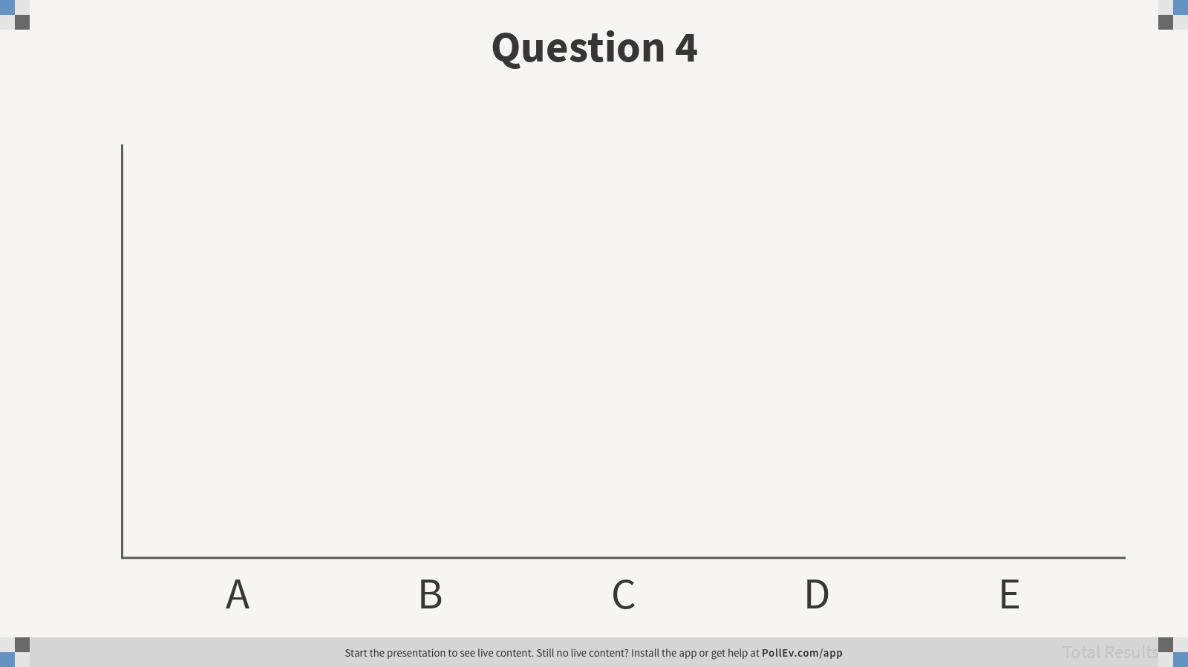
5. Which number represents a proper scale of operations approximately done on a 1000 element collection if an algorithm is logarithmic?
100000
9966
1000
10
1
Notes:
Question 4
https://www.polleverywhere.com/multiple_choice_polls/4gQR2guwMgaBjvBSXKxOM
D

Slide 37
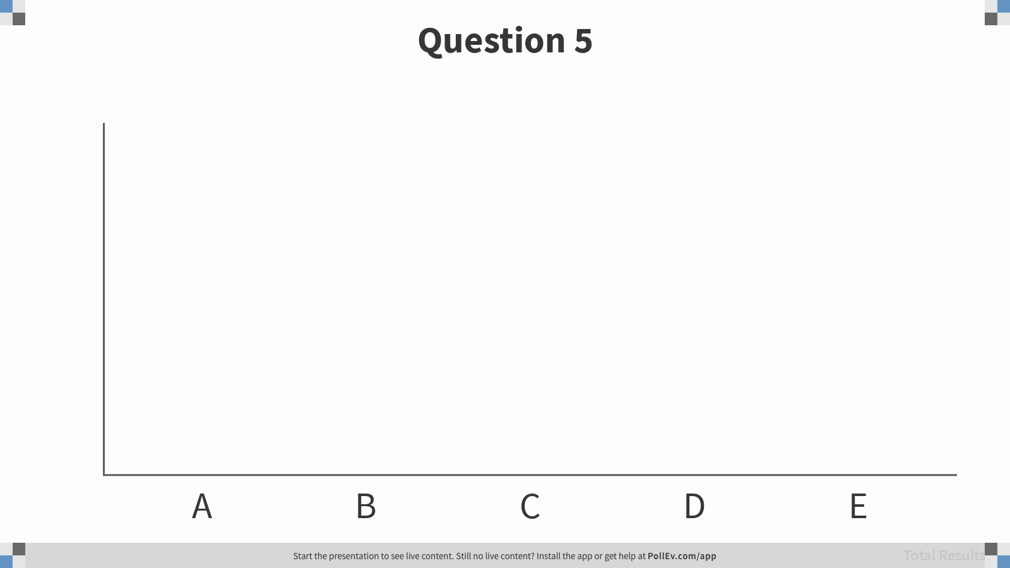
6. What is true about constant time algorithms?
They tend to be very complicated
Very few exist
They only perform a single operation
They only have one line of code
They don’t vary with the size of the collection
Notes:
Question 5
https://www.polleverywhere.com/multiple_choice_polls/biNM4zMBawPYH0ZeV9E6g
E

Slide 38
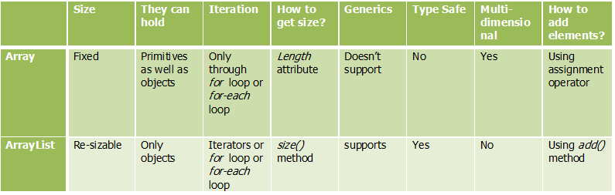
Array versus ArrayList
The array is a native programming component or data structure but ArrayList is a class from Java Collections framework, an API. In fact, ArrayList is internally implemented using an array in Java. Since ArrayList is a class it holds all properties of a class e.g. you can create objects and call methods but even though the array is an object in Java it doesn't provide any method. It just exposes a length attribute to give you the length of the array, which is constant.

Slide 39
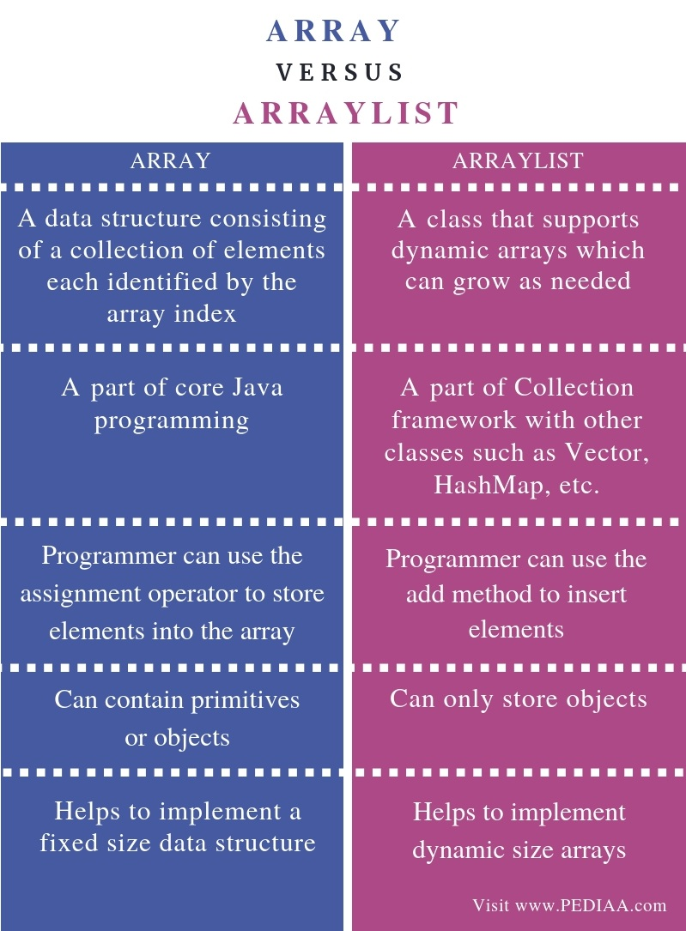

Slide 40
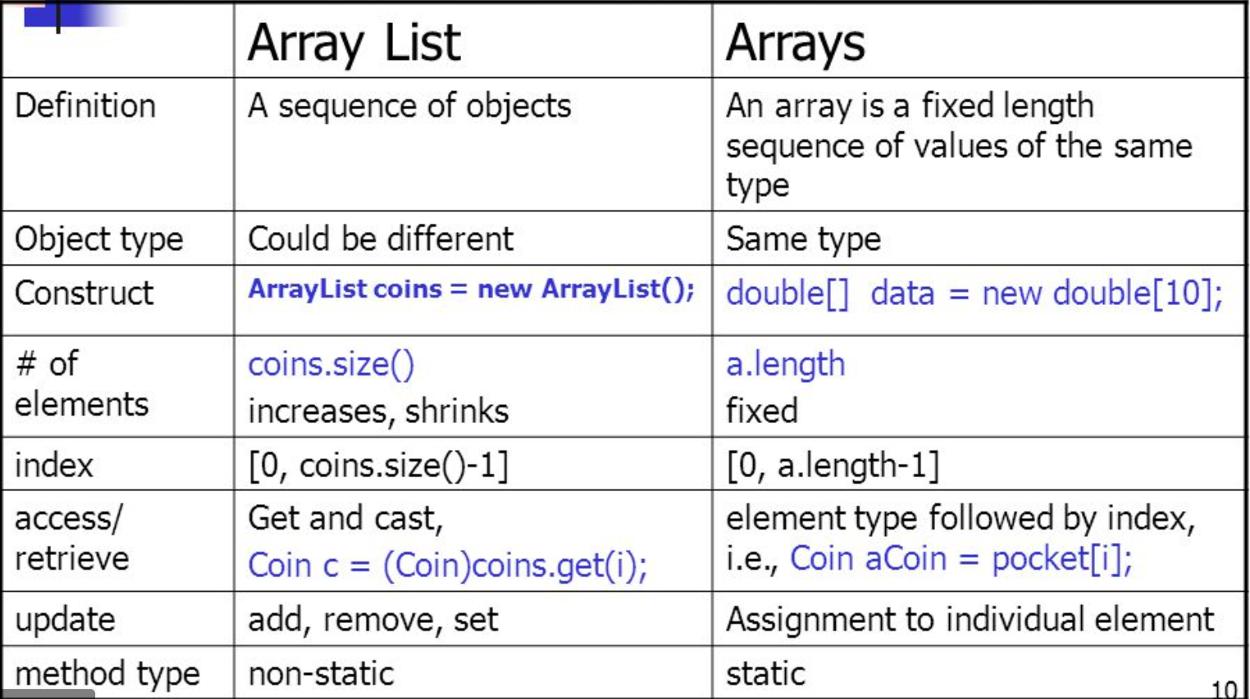

Slide 41
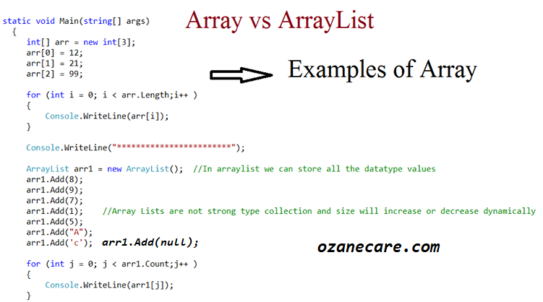

Slide 42
ArrayList

Slide 43
import java.util.Arrays;
public class MyArrayList<E> {
private int size = 0; private static final int DEFAULT_CAPACITY = 10; private E elements[];
public MyArrayList() {
elements = (E [])(new Object[DEFAULT_CAPACITY]);
}
public void add(E e) { if (size == elements.length) expandCapacity(); elements[size++] = e; }
private void expandCapacity() { int newSize = elements.length * 2; elements = Arrays.copyOf(elements, newSize); }
@SuppressWarnings("unchecked") public E get(int i) { if (i>= size || i <0) throw new IndexOutOfBoundsException("Index: " + i + ", Size " + i ); return (E) elements[i]; }
}

Slide 44
Unit Tests
Testing is the process of checking whether a program behaves correctly. Testing a large program can be hard because bugs may appear anywhere in the program, and multiple bugs may interact. Unit testing is the process of individually testing a small part or unit of a program, typically a method.

Slide 45
How to use Junit for unit testing?
A JUnit test is a method contained in a class which is only used for testing. This is called a Test class. To define that a certain method is a test method, annotate it with the @Test annotation.
This method executes the code under test. You use an assert method, provided by JUnit or another assert framework, to check an expected result versus the actual result. These method calls are typically called asserts or assert statements.
Assert statements
JUnit provides static methods to test for certain conditions via the Assert class. These assert statements typically start with assert. They allow you to specify the error message, the expected and the actual result. An assertion method compares the actual value returned by a test to the expected value. It throws an AssertionException if the comparison fails.
The following table gives an overview of these methods. Parameters in [] brackets are optional and of type String.

Slide 46
Table Methods to assert test results
Statement | Description
fail([message]) | Let the method fail. Might be used to check that a certain part of the code is not reached or to have a failing test before the test code is implemented. The message parameter is optional.
assertTrue([message,] boolean condition) | Checks that the boolean condition is true.
assertFalse([message,] boolean condition) | Checks that the boolean condition is false.
assertEquals([message,] expected, actual) | Tests that two values are the same. Note: for arrays the reference is checked not the content of the arrays.
assertEquals([message,] expected, actual, tolerance) | Test that float or double values match. The tolerance is the number of decimals which must be the same.
assertNull([message,] object) | Checks that the object is null.
assertNotNull([message,] object) | Checks that the object is not null.
assertSame([message,] expected, actual) | Checks that both variables refer to the same object.
assertNotSame([message,] expected, actual) | Checks that both variables refer to different objects.

Slide 47

11. You have a Letters class that keeps chars in an array. It has the following two methods (plus others):
public void insertFront(char);
public char getFront();
In your test method, you call
Letters let = new Letters();
let.insertFront(‘a’);
What assertion will test that the insertFront() method works?
assertEquals(let.insertFront(‘a’), let.getFront(‘a’));
assertTrue(let.insertFront(‘a’));
assertFalse(let.insertFront(‘a’));
assertTrue(let.getFront());
assertEquals(‘a’, let.getFront());
Notes:
Question 7
https://www.polleverywhere.com/multiple_choice_polls/n0deVsAwTxVOcAgRArtJX

Slide 48

12. Assume you have a method called checkRGB(int r, int g, int b). This method checks to ensure that the three parameters have values between 0 and 255 (i.e. that they are valid color values). If the values are good it returns true, otherwise false. Which of the following asserts will pass?
assertTrue(checkRGB(500, 500, 500));
assertFalse(checkRGB(256, 200, 0));
assertFalse(checkRGB( 100, 25, 200));
assertTrue(checkRGB(0,0,-1));
Notes:
Question 12
https://www.polleverywhere.com/multiple_choice_polls/JfYUPsmUzUz0mh69EgIyb

Slide 49

13. You write a method called makeTag() that takes a string as input, and removes all spaces and adds ‘#’. So “me too” becomes “#metoo”. In your test, you have the following line of code:
String result = makeTag(“United Nations”);
Which of the following tests should pass?
assertTrue(result)
assertFalse(result)
assertEquals(“#UnitedNations”, result);
assertNull(result);
Notes:
Question 13
https://www.polleverywhere.com/multiple_choice_polls/IhFMEMWUymIC7oF3aySyI

